Slide 1
Network of scholars
MA and joint Masters
Seminars and workshops
Summer School
Projects
Qualitative research
Publication series
www.um.edu.mt/emcer

Slide 2
Education and transition to employment
Link is complex: education can contribute
Avoid exporting problem (e.g. ‘employability’)
Many things can help transition
Economic policies (e.g. limit informal economy)
LM policies that favour youth (incentives to employ young people)
Education policies (e.g. apprenticeships; connected pathways; valuing of TVET; 2nd chance schooling; alternative assessment; strong pedagogies)
4. Career guidance has a role to play

Slide 4
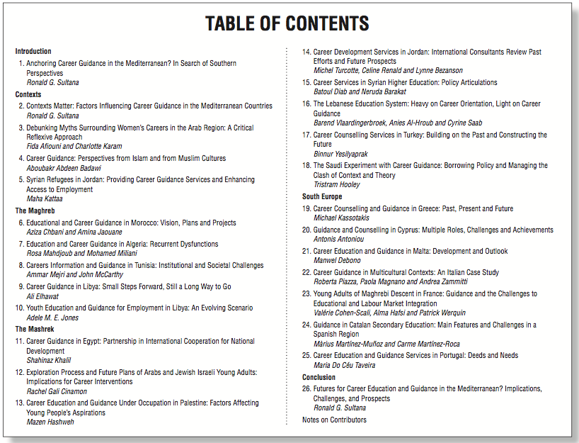

Slide 5
CG supporting youth transitions
Reflexive about work and training futures (DOTS)
Teaches skills to manage livelihood
Increases awareness of opportunities
Work exploration/shadowing
Entrepreneurship (e.g. INJAZ)
Contests gender/class ‘bounded horizons’
Motivates students (including NEETs - PAP)
Extends social capital/networks
Can promote TVET route
APEL – supports LM integration of specific groups

