Slide 1

The Potential of Renewable Energy in Libya
Prof. Faisal A. Mohamed Elabdli
General Director
Authority of Natural Science Research and Technology

Slide 2
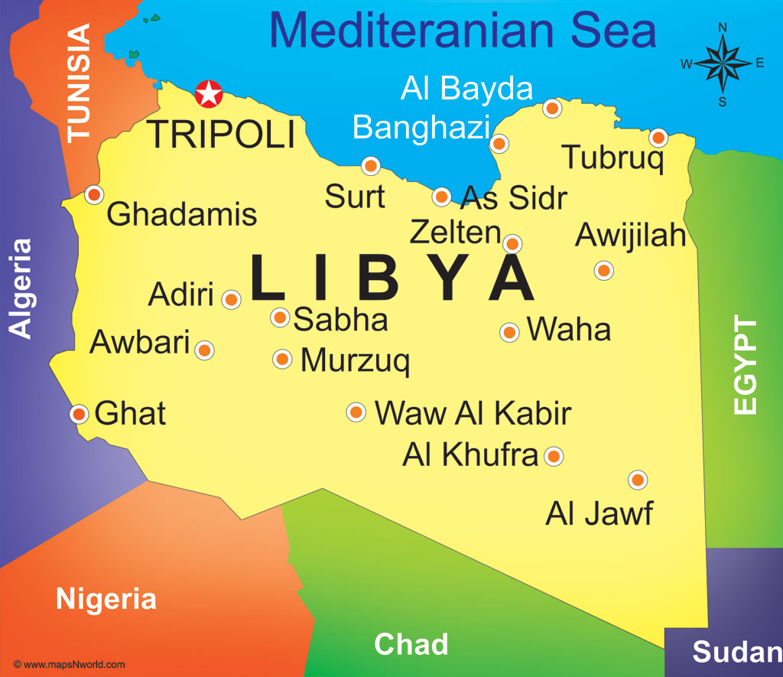
Libya Profile
  Area - 1.7 Million square kilometers
  Capital - Tripoli
  Population - 6.5 Million
  Main resources - Oil and gas
  Main industries - Petroleum, steel, cement and textiles.

Slide 3
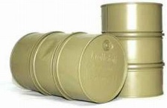

Main Resources
Resource
Libya’s resources
Libya in comparison
Oil
  Proven oil reserves of 43 billions BOE with additional potential
  Largest oil reserves in Africa
Gas
  Gas reserves of 10 billions BOE
  Fourth largest natural gas reserves in Africa

Slide 4
Electric peak load development

Slide 5
Electricity consumption per sector

Slide 6

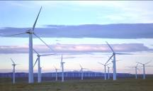
Renewable Energy in Libya
Resource
Libya’s resources
Libya in comparison
Solar
  Average solar radiation of 2,470 kWh/m2/day
One of the highest solar radiation in the world
Wind
  High average wind speed at several locations
Attractive global location for wind farms

Slide 7
Solar Energy Potential
Global solar radiation
Direct normal solar radiation

Slide 8
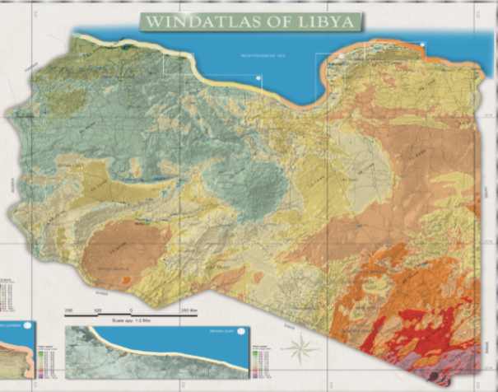
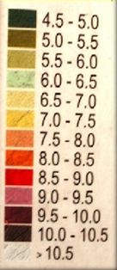
Wind energy potential
Wind speed (m/s)
m/s
  26 meteorological stations were installed in different places in Libya to measure the wind speed and identify the most suitable places for wind farms.
  Based on measurements from meteorological stations and satellite data ,the wind atlas for Libya has been achieved.

Slide 9
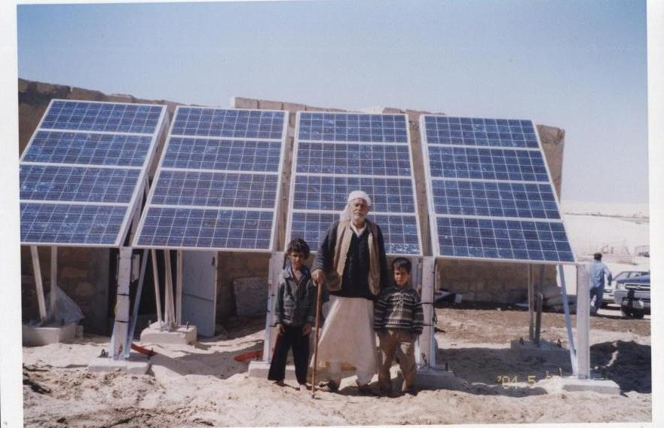
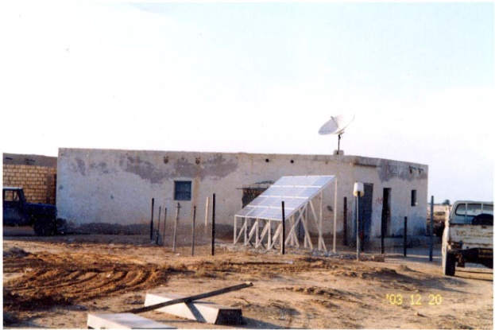
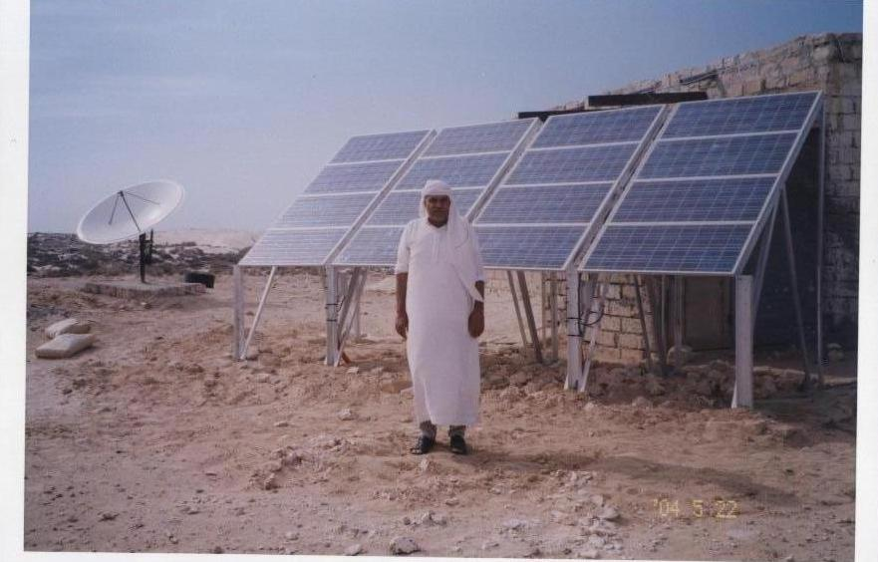
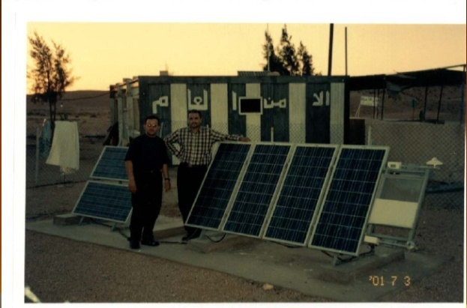
Renewable energy applications in Libya
PV in Rural Electrification
The use of PV systems for rural electrification and
lighting was started in 2003
318 PV systems were installed to supply small remote area with a total power 236 KWp

Slide 10
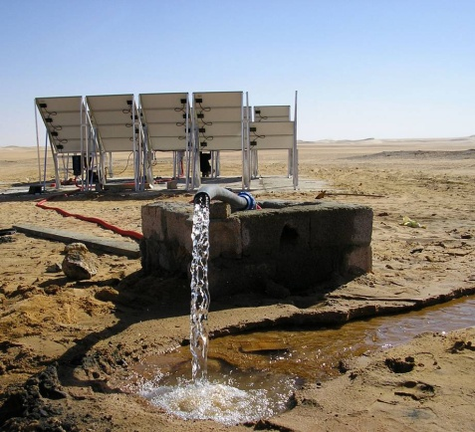
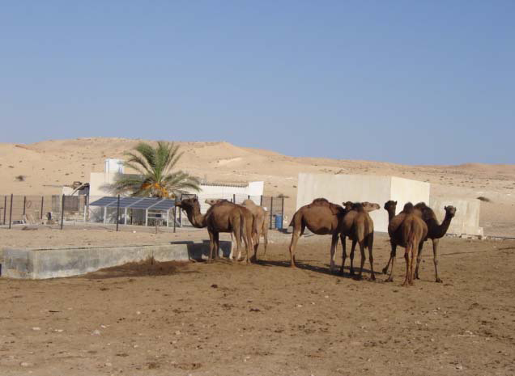
PV for Water pumping
Projects in the field of water pumping was started 1983 where PV pumping system was used to pump water for irrigation at El-Agailat
The water pumping project consists of installing of 10 PV systems with a total estimated peak power for this application is 40 KWp.

Slide 11
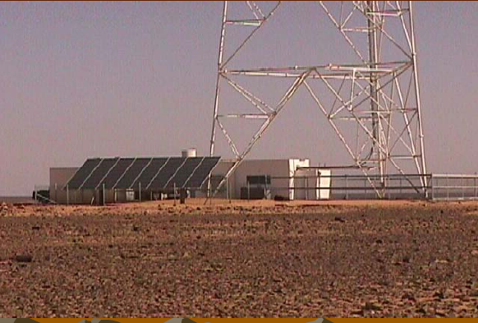
    PV in Communication Networks
Projects in the field of communication was started 1980 where a PV system was used to supply energy to a microwave repeater station near Zella
The total number of stations running by PV in the field of communications exceeding 120 stations
The total installed photovoltaic peak power installed is around 3 MWp

Slide 12
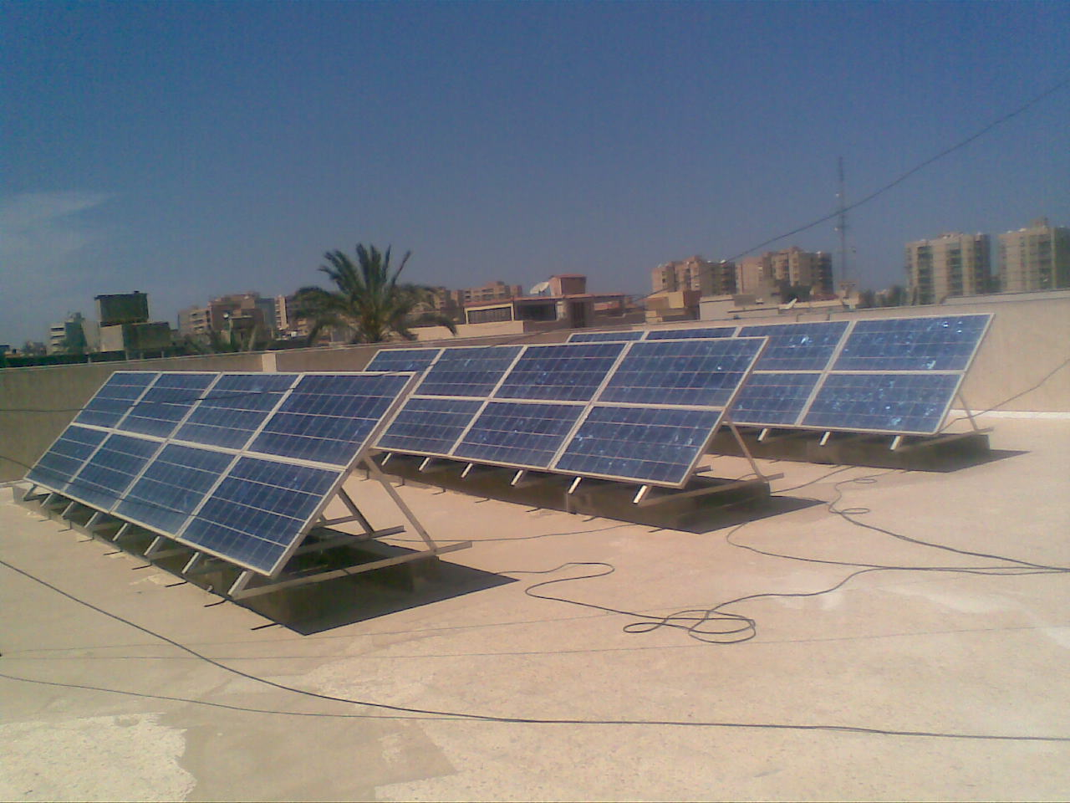
    PV in Roof top systems
The use of PV grid connected roof top systems was started in 2010.
10 PV grid connected roof top systems were installed with a capacity of 3 KWp each.

Slide 13
    PV in Cathodic protection
The first project put into work was in 1976 to protect the oil pipe line connecting Dahra oil field with Sedra Port.
The total PV systems in this field is around 320 systems, with a total installed PV systems of 650 KWp.

Slide 14
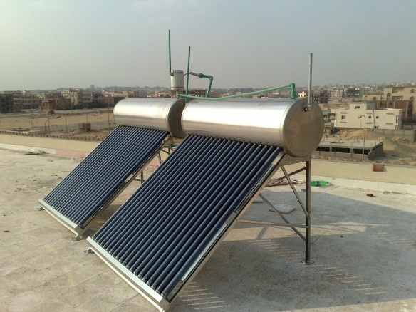
    Solar thermal application
The use of domestic solar heater started in 1980 by installing a pilot project of 35 systems.
There are all together about 6000 solar heaters in Libya.

Slide 15
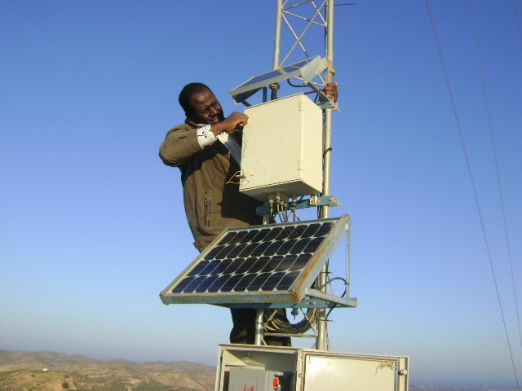
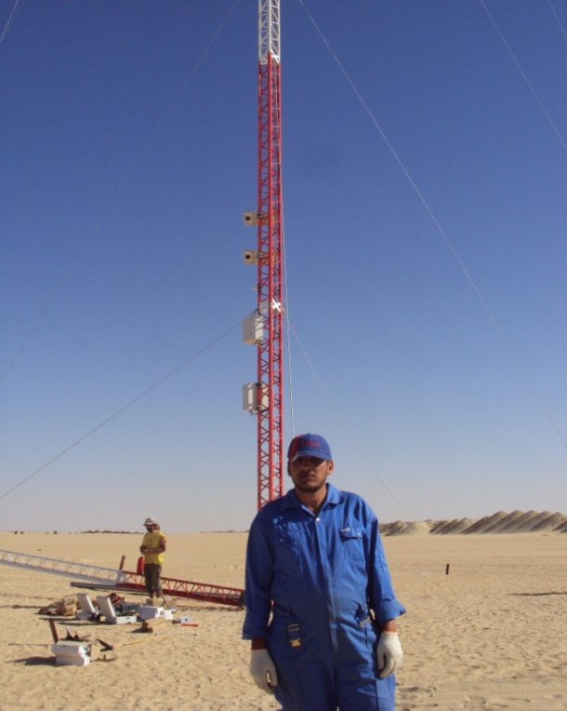
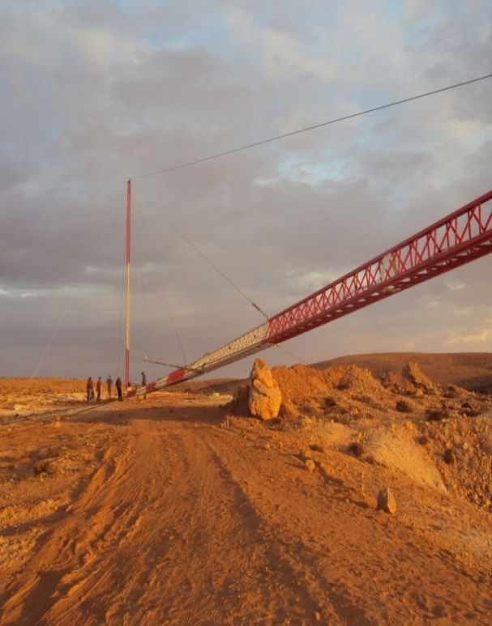
    26 Meteorological stations for wind energy were installed in different locations in Libya

Slide 16

Renewable Energy Plan in Libya
2020
2015
10% RE Share
1500 MW Wind
800 MW CSP
150 MW PV
300 MW SWH
6% RE Share
750 MW Wind
100 MW CSP
50 MW PV
150 MW SWH
2010
The plan is stopped due to
the political instability

Slide 17
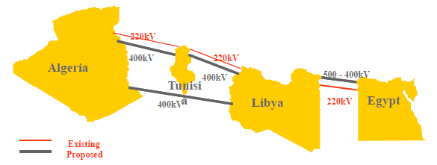
Libya-Electricity Interconnection

Slide 18
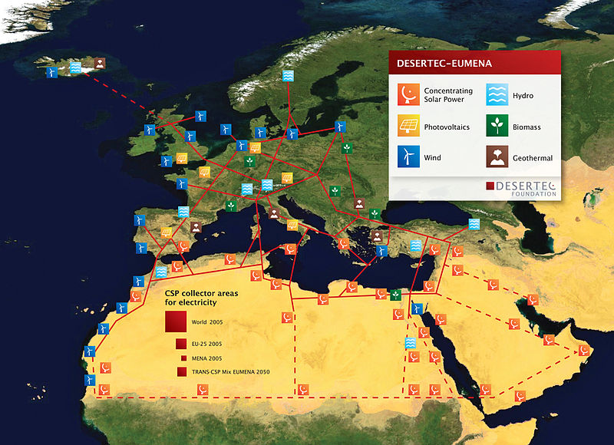
Europe-MENA Renewable Energy Integration Project (Desertec)

Slide 19
Renewable Energy Key Players in Libya
Centre for Solar Energy Research and Studies (CSERS)
Renewable Energy Authority of Libya (REAOL)

Slide 20
Conclusions
The success of renewable energies deployment in Libya requires number of procedures including:
Adoption of short and long term strategic plan of renewable energy in the country.
Consideration in the treatment of energy legislation in general and electricity sector in particular, and especially open. Market to competition and break the monopoly of the production of electric power.
necessity of a regulatory body for coordination between the various bodies, control and maintain the rights of the consumer and the adoption of different tariffs,
Login in financing through joint investment will require legislation to ensure buy energy produced at a rewarding prices (cost + profit margin) and endure the pricing difference

Slide 21
Conclusions
Urging the Libyan institutions and local financial institutions to participate in the investment in technologies and renewable energies.
Directing a percentage of current support for conventional energy sources (fuels of various kinds) to support the development of renewable energy sources; consideration of passing legislation and incentives that encourage the deployment of the use of renewable energy applications.
The need to contribute to the proposed international initiatives, and participate in the development of renewable energy technologies can even local settlement of these techniques, and lack of dependence on foreign companies and institutions.
Support of the executive and research in the field of renewable energies in all material and moral means.

