Slide 1



Medthink
Malta, 1-2 July 2019
Coherence and effectiveness
Samir Grimes
Algeria

Slide 2

Mediterranean maritime sectors (tourism, shipping, aquaculture, offshore Oil &Gas), except professional fisheries, expected to grow - next 15 years,
Intensifying existing causes of risk for environmental degradation & hybrid threats
Complexity & uncertainties (political circumstances, stability, funding, ecological and climate trends)
Strong NSC gaps (economic resilience, capacities, technology, funding, regulation and procedures, development, SPI framework, RI’s, etc.)
WestMed, Bluemed, UfM and UN/MAP technical groups, networks (MedCC), SPI, etc.

Slide 3
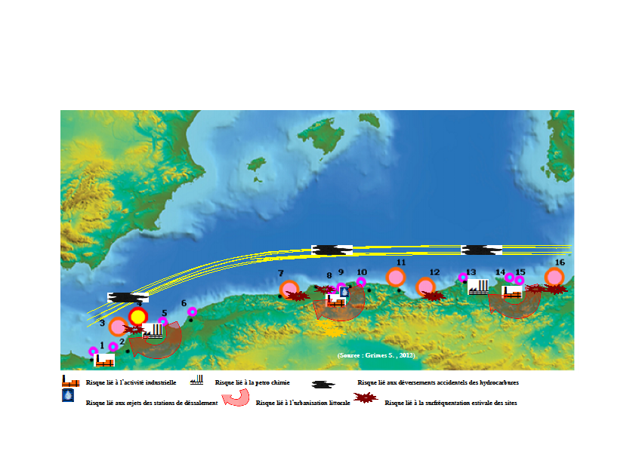
Case of Algeria
Source : Grimes et al., 2019)
Source : Atkins, Pescares, GIZ, SML/UE, 2018)

Slide 4
General view on maritime activities along Algerian coasts

Slide 5

Less than 08 months
BlueMed
Barcelona
23-25.10.18
WestMed
Palermo
13-15.05.19
BlueMed
Paris
13-14.06.19
WestMed
Napoli
30. 11. 17
WestMed
Algiers
03-04.12.18
National DATABASE - BE
Blue Economy National Committee
04.02.19
National Strategy and Action Plan of BE

Slide 6
Fisheries & aquaculture, drivers for Blue economy
Shipbuilding & repair
Maritime transport & port authorities
MSE’s
Maritime and coastal tourism
Local authorities
Fisheries-Aquaculture
Desalinisation
Marine and coastal conservation
Research and capacity building

Slide 7
What we learn in these few months
New tools, ways and framework innovative cooperation
Optimize the existent framework
Enlarge the Mediterranean blue economy community at different scales
Connect specific data to specific needs
Organize the system (clusters) ? Aggregate data for donors and investors ?

Slide 8
Key messages
Weak leadership is taken by the south Mediterranean countries
The consultations are very brief and the participation of the southern shore countries in the design of the projects is low
The capacity building process must be thoroughly reviewed in order to allow a real transfer of knowledge and expertise from the north to the south
Very few south-south initiatives, non-existent

Slide 9
Positive
Maritime communities are more gathered together than before with more multidisciplinary at meetings.
More opportunities in collaborations
More links between start up
Support gender and young involvement
Major gaps
Cooperation model must be reviewed as it is based essentially on European criteria and format
The gap in institutional and legislative framework between the Mediterranean northern and southern countries penalized the successful completion of cooperation projects in an appropriate form
Lack of knowledge of European and other funding mechanisms by SC
Lack of coordination between the different focal points (projects, programmes, initiatives) inside the southern countries

Slide 10
Recommendations for action
Set up task forces in the SC on BE funding mechanisms.
Lighten internal procedures for participation in calls from southern stakeholders
Accelerate the process of signing the various agreements likely to improve the eligibility of SC to European funding
Strengthen on all B priorities the accelerators of SMEs likely to improve employability in the maritime sectors and achieve a real transfer of technology and know-how
Integrate biodiversity issues in the deep seabed of the Western Basin in future thematic

Slide 11
  Reduce the barriers between decision-makers, scientists and economic sphere
Complexity of problems, requires the cooperation at all scales and multidisciplinary approach
Need to support transboundary approach and innovative operational cooperation
Need to deal with a changed context.

